Slide 1
RENEGOTIATIONS IN TRANSPORTATION PUBLIC-PRIVATE PARTNERSHIPS: THE U.S. EXPERIENCE
Jonathan L. Gifford, Ph.D.
[with Lisardo Bolaños and Nobuhiko Daito]
George Mason University
jgifford@gmu.edu / 703-993-2275
Moving Forward to Sustainable and Credible PPP: Meeting Challenges through better Governance
Asian Development Bank
Korean Development Institute
World Bank
Seoul, Korea
December 10th, 2014

Slide 2
Presentation Outline
Scope of the presentation
Why the U.S. presents a different context for P3s
Theoretical perspectives
The U.S. situation
Six case studies in the U.S.
Discussion
Conclusions
Q&A and general discussion

Slide 3
Scope: A Broad Understanding of Renegotiations in the United States
Policy interest
Public concern about rent seeking and opportunism
Concerns about what should be public policy
Academic interest
Is the U.S. experience comparable to global experience?
We look at: renegotiations, defaults, bankruptcies and buy-outs
What can be said in the absence of a clear test to evaluate motives (opportunism, external shocks, contract complexity, and winner´s curse)

Slide 4
Scope: Types of Renegotiation Events: Contract Modifications, Defaults, Bankruptcies, and Buy-outs
Contract Modifications
Buy-outs
Modifications to P3 contractual agreements
A new owner (with different reputation and capabilities) buys the P3 project
Defaults
Bankruptcies
The private partner fails to meet debt service. It may still be able to operate the facilities
Legal proceeding when the private partner is unable to repay its debt. The assets are used to pay part of it, ownership may change.

Slide 5
Why the U.S. Context Matters: Federal System, Common Law and Bankruptcy Law (Chapter 11)
Federal System
Common Law and Chapter 11
Fragmented authority
Institutional heterogeneity
Relies on legal precedent, not on legislation, subject to contradictory principles.
P3 Relevance
P3 Relevance
Federal: loan program
State: authority and assets
Local: delegated authority and assets
Defaults do not put operations in danger
Bankruptcies have had minimum impact on public sector

Slide 6
Why the U.S. Context Matters: P3 Financing Mechanisms
U.S. relies on non-recourse financing.
This disciplines the private sector
while increasing the risk of the project
Project equity
Non-recourse financing
Mezzanine equity
Higher
expected
return
Spread
Taxable debt
Tax financed or Tax-exempt bond
Risk to public sector
Risk to private sector
Source: Based on Josh Evans, Bostonia Partners (July 2014)

Slide 7
Theoretical Perspectives (1) Opportunism and Exogenous Changes
Renegotiation occurs because one of the parties takes advantage of an (inherently) incomplete contract
Renegotiation occurs as one or both parties aim to adapt the original contract to current unexpected exogenous events
Variables
Variables
Public:
Change of leadership (“roving bandit,” political contestability)
Private:
Experience with renegotiations
Macroeconomic variables
Inflation (consumer, producer)
Economic growth (stagnation)
Unemployment
Interest rates
Notes:
Mancur Olson: Roving bandits vs. Stationary bandits, and how long-term horizons affect incentives of political authorities.
Political Contestability: highly competitive environment may affect how elected officials behave.

Slide 8
Theoretical Perspectives (2) Contract Complexity and Winner´s Curse
P3s are common for complex projects, which may exacerbate uncertainty, and trigger renegotiations
Renegotiation occurs when, in the presence of uncertainty, the winner is the bidder with the most optimistic expectations
Variables
Variables
Design (length, bridges/tunnels)
Contract design (type, duration)
Experience (novelty of the P3s)
Political env. (ethnic fractionalization)
Institutional env. (state management capacity and regulatory body)
Process to award the P3
Number of bidders
Bids

Slide 9
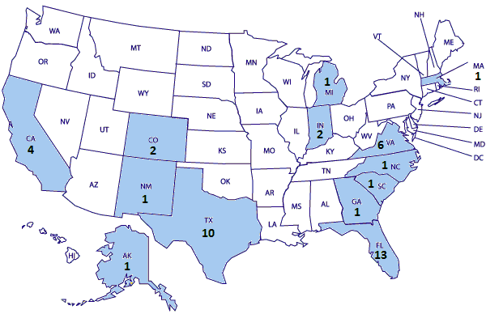
The U.S. Situation: Geographic Distribution of Highway P3s in the U.S.
Puerto Rico not shown. Source: Public Works Financing and InfraDeals

Slide 10
The U.S. Situation: History of Highway P3 Renegotiations in the U.S.
Source: Public Works Financing and InfraDeals
Notes:
As of October 2014.
Projects with more than one renegotiation are only included once.

Slide 11
The U.S. Situation: The 6 Case Studies Under Analysis
California
SR 91 Express Lanes (SR19)
South Bay Expressway (SBX)
Indiana
Indiana Toll Road (ITR)
Virginia
Dulles Greenway (DG)
Pocahontas Parkway (PP)
Downtown Tunnel / Midtown Tunnel / MLK Extension or Elizabeth River Crossings (ERC)
State | P3 Highways | P3 Highways with Renegotiations | Cases Under Analysis
Alaska | 1 | 0
California | 4 | 2 | 2
Colorado | 2 | 1
Florida | 13 | 1
Georgia | 1 | 1
Indiana | 2 | 1 | 1
Massachusetts | 1 | 0
Michigan | 1 | 1
New Mexico | 1 | 1
North Carolina | 1 | 0
South Carolina | 1 | 1
Texas | 10 | 4
Virginia | 6 | 5 | 3
TOTAL | 45 | 18 | 6
Source: Public Works Financing and InfraDeals

Slide 12
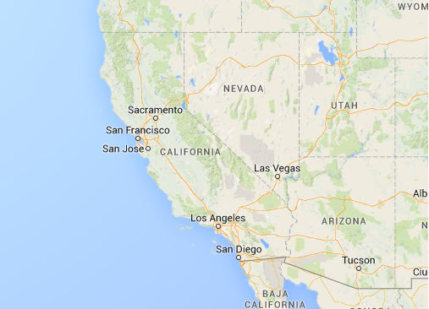
Case Study 1 – SR 91 Express Lanes (SR91)
Concessionaire | Level 3 Communications, Vinci Autoroute, & Granite Construction
Financial close | 1993
Facility Open | 1995
Revenue source | Toll
Contract type | DBFOM
Original cost (US$) | 88.3 million (1990)
Constructed Length | 10 miles (16.1km)
Bridge / Tunnels | No / No
Los Angeles, California
Renegotiations
2003: OCTA purchases the project for $341.5M to eliminate non-compete clause, after attempts to breach the contract by the public sector

Slide 13
Case Study 2 – South Bay Expressway (SBX)
Concessionaire | PB, Egis Projects, Fluor Daniel, Prudential Bache; then Macquarie
Financial close | 2003
Facility Open | 2007
Revenue source | Toll
Contract type | DBFOM
Original cost (US$) | 400 million (1990)
Constructed Length | 12.7 miles (20.4 km)
Bridge / Tunnels | Yes / No
San Diego, California
Renegotiations
2010: SPV files for bankruptcy (Chapter 11)
2011: Exits bankruptcy. MIG equity to zero. Owners are lenders, incl. USDOT
2011: SANDAG purchases part of the equity share. Changes in USDOT’s stake in the project: Pre2011: $140M TIFIA debt & $32M in capitalized interest Post2011: $6M equity & $93M debt obligation from toll revenues, 32% ownership

Slide 14
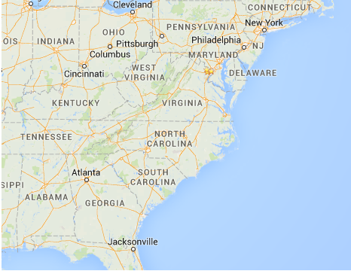
Case Study 3 – Indiana Toll Road (ITR)
Concessionaire | Cintra & Macquarie
Financial close | 2006
Operation began: | 2006
Revenue source | Toll
Contract type | DBFOM + OM
Original cost (US$) | 3,778 million (2006)
Constructed Length | 10 miles (16 km) to build & 150 miles (240 km) to maintain
Bridge / Tunnels | No / No
Indiana
Renegotiations
2006: “Toll freeze” until electronic tolling in place in exchange for $60 million. Reduction in investment obligations
2007: Reduction in investment obligations to build a toll plaza.
2008: Reimbursement of $60 million due to electronic tolling
2010: Delays on investment obligations (1.5 miles – 3 years; 3.4 miles – 1 year)
2014: ITR filed for bankruptcy (Chapter 11). Private loss estimated in $700 million.
Cintra is considering a bid to buy it out of bankruptcy.
Notes:
2007: No: Eastpoint Toll Plaza (km 145.7).
2010: Two changes:
Expand to 3 travel lanes in each direction from Milepost 14.0 to 15.5, from December 31, 2008 to December 31, 2011.
Expand to 3 travel lanes in each direction from Milepost 10.6 to 14.0, and lower toll road elevation to accommodate the flight path of Gary Chicago Int´l Airport, from December 31, 2010 to December 31, 2011.

Slide 15
Case Study 4 – Dulles Greenway (DG)
Concessionaire | Shenandoah Group, Kellogg Brown & Root
Financial close | 1993
Facility Open | 1995
Revenue source | Toll
Contract type | DBFOM
Original cost (US$) | 350 million (1993)
Constructed Length | 14 miles (22.5km)
Bridge / Tunnels | Yes / No
Loudoun, Virginia
Renegotiations
1995: Owners defaulted on debt.
1997: Tolls increased and speed limit increased
1999: Debt restructured. Project modified (from 2*2 lanes to 3*3 lanes)
2001: Extension of concession period (+20 years)
2004: Change in tolls (variable peak and discounted off-peak point-to-point rates)
2005: Macquarie Infrastructure Group (MIG) buys it
2013: Mechanism to define tolls is changed (highest: CPI+1%, real GDP, or 2.8%.)

Slide 16
Case Study 5 – VA SR895 Pocahontas Pkwy (PP)
Concessionaire | Fluor Daniel & Morrison Knudsen
Financial close | 1998
Facility Open | 2002
Revenue source | Toll
Contract type | DBFOM
Original cost (US$) | 381 million (1998)
Constructed Length | 8.8 miles (14km)
Bridge / Tunnels | Yes / No
Richmond, Virginia
Renegotiations
2006: Transurban USA buys it, concession period is extended to 99 years and investment increases: 1.6 mile, four-lane road and electronic tolling
2012: Transurban USA writes off equity but operation continues
2014: Transurban USA transfers operations to DBi Services

Slide 17
Case Study 6 – Downtown Tunnel/Midtown Tunnel/MLK Extension or Elizabeth River Crossings (ERC)
Concessionaire | Skanska & Macquiare
Financial close | 2012
Facility Open | Expected 2017
Revenue source | Toll
Contract type | DBFOM
Original cost (US$) | 2,089 million (2012)
Constructed Length | 2.2 miles (3.5km)
Bridge / Tunnels | Yes / Yes
Norfolk, Virginia
Renegotiations
2012: toll delayed in exchange for $100 million (2012)
2014: toll decrease in exchange for $82.5 million (2014)
Notes:
Va Supreme Court decision on constitutionality of tolls.

Slide 18
Discussion
Opportunism
Exogenous Changes
Evidence
Evidence
Public:
CA: SR91 – govt attempted to breach non-compete clause
CA: Professional Engineers in California Governments’ alleged influence on SBX?
VA: high contestability; possible source
Private:
Concessionaires experienced with renegotiations
Problem:
Evidence of opportunism limited
Additional analysis is needed to evaluate the relationship between the variables and opportunism
Economic growth and unemployment may have affected: DG, SBX, PP, partly ITR
SBX may have been affected by sudden price increases in construction machinery manufacturing and iron and steel mills
Interest rate changes affected DG and ITR

Slide 19
Discussion
Contract Complexity
Winner´s Curse
Evidence
Evidence
Technical complexity: high in SBX, considerable in other projects
Novelty of the P3 model: SR91, ITR, DG, SBX, and PP
Political viability (e.g., fiscal/tolling, environmental, civil rights concerns)
VA strongest institutional environment
Technical complexity, duration, and complicated political environment a potential problem for ERC
ITR appears to have been subject to some degree of winner´s curse:
Bidding process
Four bidders
Cintra & Macquarie: $3.8 billion
Indiana Road Co LLC: $2.8 billion
Itinere I S.A.: $2.5 billion
Indiana TRP LLC: $1.8 billion

Slide 20
Conclusions
Factors associated with renegotiations in the U.S. P3 market:
External shocks: e.g., economic growth, inflationary pressures, and interest rate hikes (Dulles Greenway, South Bay Expressway, Pocahontas Pkwy, and Indiana Toll Road)
Contract complexity, due to the novelty of these type of projects
Political environment: e.g., resistance to private provision of public goods
Complex projects, with high uncertainty, difficult to account for in contracts
No definitive evidence of opportunism.
Winner´s curse effect may have been present in Indiana, given the gap between the winner´s bid and what others submitted.
Government losses to date: South Bay Expressway may bring losses to U.S.DOT; Dulles Greenway 20-year term extension
Further research needed

Slide 21
Center for Transportation Public-Private Partnership Policy George Mason University
Expanding the evidence base, enhancing agency capacity, educating the workforce and community about P3s
For more information:
Visit us at: p3policy.gmu.edu
Jonathan L. Gifford, Ph.D.
George Mason University
School of Policy, Government, and International Affairs
3351 Fairfax Drive, Arlington, VA 22201 USA
jgifford@gmu.edu / +1(703)993-2275

