Slide 1
U.S. Transportation Public Private Partnerships: Governance and Institutional Arrangements
Jonathan L. Gifford, Ph.D.
George Mason University
jgifford@gmu.edu / +1-703-993-2275
Moving Forward to Sustainable and Credible PPP: Meeting Challenges through better Governance
Asian Development Bank
Korean Development Institute
World Bank
Seoul, Korea
December 9th, 2014

Slide 2
Outline
Examples of How U.S. is Different
The Federal System and South Bay Expressway
The Common Law System and Elizabeth River Crossings
The Political Environment and how it affects P3 projects
The U.S. Federal System
The Federal government, and its financial initiatives
The State governments, their authority and financial decisions
The Local governments, and their financial options
Case studies
Chicago Infrastructure Trust
Virginia Office of Public-Private Partnerships (OTP3)
Conclusions

Slide 3
Why the U.S. Context Matters: Federal System
Federal System
Coordination is hard to achieve: authority is fragmented between and within levels of government
Experimentation allows innovation: institutional heterogeneity creates opportunities
P3 Example of its relevance
South Bay Expressway
The State of California implements the P3 project
Some Federal agencies oppose the project on environmental grounds
A group of Local governments buy the asset

Slide 4
Why the U.S. Context Matters: Common Law
Common Law
It relies on legal cases, not on legislation which is subject to contradictory principles.
Previous experiences shape what may be expected from the contractual relationship
P3 Example of its relevance
Elizabeth River Crossings in Virginia
Project included tolls in pre-existing infrastructure to finance the project
Lawsuit contending the tolls were unlawfully imposed taxes threaten other tolls in the state
Virginia Supreme Court ruled in favor of the tolls

Slide 5
Why the U.S. Context Matters: Common Law
Political Environment
The American political environment is more contested and the bureaucratic process is different than in other countries
In the US, P3 projects in a pipeline, it is made public very early in the process to account for the opinion of citizens.
Litigation, by citizens, is an important avenue to oppose political and bureaucratic decisions
P3 Example of its relevance
US presents a huge infrastructure market opportunity, but political risk is an issue
Several projects that have been canceled or nearly canceled: Purple Line, 460, U.S. 36 in Colorado, etc.

Slide 6
The U.S. P3 Governance Structure in Detail
Federal
Grant and loan programs on infrastructure
Deductibility of municipal bond interests
State
Authority resides here
Some of the assets are in this level
Implements some of the transportation P3 projects
Local
Some of the assets are in this level
Implements some of the transportation P3 projects

Slide 7
Federal P3 Initiatives: U.S. Federal Highway Trust Fund
U.S. Highway Trust Fund
Originated in 1956 to finance the Interstate Highway System
Federal fuel tax ($0.183/gal [$0.048/l] gasoline and $0.244/gal [$0.064/l] diesel)
Funding Crisis
Increasing costs of construction
Aging infrastructure: increasing cost of maintenance / renewal
Improving fuel efficiency (e.g. electric vehicles pay no gas gax)
Political opposition to raising gas tax
Recommendations include raising it to $0.40/gal [$.106/l]
Note: U.S. Congressional Budget Office projections published in 2013

Slide 8
Federal P3 Initiatives: U.S. Federal Highway Trust Fund
End of Year Balances in Highway Trust Fund, 1957 - 2021
Note: U.S. Congressional Budget Office projections published in 2013

Slide 9
Transportation P3 – A Growing Relevant Alternative Under These Conditions
Source: Public Works Financing

Slide 10
Federal P3 Initiatives: Transportation Infrastructure Financing and Innovation Act (TIFIA)
Main federal infrastructure financing program affecting P3 market
Assistance Types:
Direct Loan
Loan Guarantee
Subordinate to other project debt
“Springing lien” in case of default
Credit assistance with fixed rates lower than private market
(e.g. 3.03%, up to: 5 years of grace, 35-year loan, as of Nov 24, 2014)
Maximum share of project costs financed by TIFIA: 49% (increased from 33% in 2012)
Active TIFIA portfolio: $17.4Billion, for projects totaling $64.5billion (nominal US$)
Note: http://www.fhwa.dot.gov/ipd/tifia/guidance_applications/ https://www.treasurydirect.gov/GA-SL/SLGS/selectSLGSDate.htm

Slide 11
Federal P3 Initiatives: Transportation Infrastructure Financing and Innovation Act (TIFIA)

Slide 12
Federal P3 Initiatives: Recent Programs
Moving Ahead for Progress in the 21st Century Act (MAP-21, July 2012)
Budget Authority for TIFIA:
$750 million for 2013. $1.0 billion for 2014
Equivalent to lending capacity of $7.5 billion (2013) and $10 billion (2014), compared with annual lending capacity of $1.2 billion in prior years
USDOT expects to offer $1.7 billion in credit assistance
Could leverage $20-$30 billion in transportation infrastructure investment.
USDOT required to develop:
Policy and procedure to promote public understanding
Best practices and “standard public-private partnership transaction model contracts”

Slide 13
P3s: State Initiatives
“The powers not delegated to the United States by the Constitution, nor prohibited by it to the States, are reserved to the States respectively, or to the people”
States are the primary locus of P3 policy in the U.S.
Owners of the highway network
Out of 50 States and 5 territories
33 U.S. States and one U.S. territory with enabling statutes
13 U.S. States and one U.S. territory actively pursuing Highway P3s.
Most activities occur in California, Florida, Texas, New Jersey, Massachusetts, New York and Virginia (Puerto Rico also active)
Local governments less active in highway P3s
Examples: Chicago Skyway Toll Bridge System lease, Eagle P3 Project in Denver, Presidio Parkway in San Francisco
Notes:
The U.S. has 14 territories out of which only 5 have permanent, nonmilitary population

Slide 14
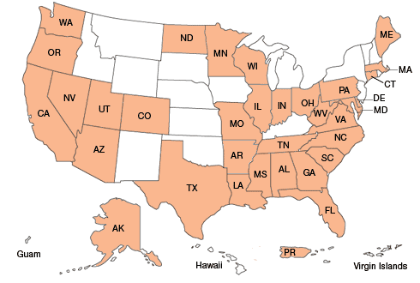
U.S. P3 Market Overview
33 States, 1 Territory with Enabling Legislation
Source: U.S. Federal Highway Administration Office of Innovative Program Delivery (retrieved: June 2014)

Slide 15
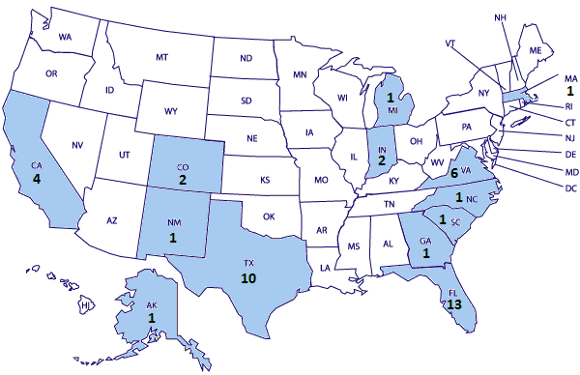
Geographic Distribution of Highway P3s in the U.S.
Puerto Rico not shown. Source: Public Works Financing and InfraDeals

Slide 16
P3s: Funding vs Financing
Financing Mechanisms
Funding Mechanisms
Demand risk: I-495 Capital Beltway HOT Lanes (VA)
Availability payments: I-595 Express Lanes and I-4 Ultimate Project (FL)
Financing Mechanisms
Private equity
Bonds, including municipal bonds
Bank loans
TIFIA loans

Slide 17
U.S. Municipal Bond Market for P3 Projects
“Municipal” bonds (state and local) a principal source of capital for infrastructure
Characteristics of U.S. Municipal Bonds
Tax Exemption: U.S. Government exempts interest income paid to bond holders
Allows lower interest rates for bonds than for taxable bonds
Legal authority to infrastructure debt-financing varies across states
States with constitutional pay-as-you-go requirements vs.
States with large General Obligation bonds
All states require balanced operating budget and some have debt capacity
U.S. Municipal Bonds
Total municipal debt is $3.7 trillion (2012Q4, SIFMA)
Historically stable to size of economy (15-20% of GDP)
Types:
General Obligation Bonds (“full faith and credit” of governments)
Revenue Bonds (non-guaranteed, with particular revenue stream for repaying obligations)
63-20 Non-Profit Corporations
Given authority to issue tax exempt bonds for infrastructure projects
Example: SR895 Pocahontas Parkway (Virginia)

Slide 18
Case Study: Chicago Infrastructure Trust
Nonprofit organization established by Chicago’s City Council, including
Mass transit
Highways
Freight rail
Airports
Maritime ports (Lake Michigan)
Aims to leverage $1.7 billion from private investors for infrastructure
Results so far
It has faced serious problems
No transportation project
1 project to retrofit 62 buildings for $25 million
The city will pay 4.95% for 15 years, based on energy savings

Slide 19
Case Study: Virginia Office of Public-Private Partnerships (VAP3)
Public-Private Transportation Act of 1995
Responsible for developing and implementing a statewide program for project delivery
Some characteristics of VAP3
Independent office under VA Secretary of Transportation
Full time staff dedicated to P3 projects
Established procedures: PPTA Implementation Manual and Guidelines
Accepts unsolicited proposals (review fee: $50K)
Source: www.P3virginia.org and KPMG (2013)

Slide 20
Case Study: VAP3 Project Milestones and Opportunities for Public Involvement
Key Project Milestones | Public Notice / Involvement / Opportunities
Development of PPTA Projects Priority List | Notification of General Assembly members by VAP3 Director; MPO’s; Agency Administrators; public input solicited; posting on VAP3 website; press releases
Project Development | CTB Location approval, CTB proposed Business Terms; public meetings; public input solicited on proposed Business Terms; posting on VAP3 website; press releases.
Request for Qualifications | Notification of General Assembly members by VAP3 Director; MPO’s; Agency Administrators; posting on VAP3 website; press releases.
Request for Proposals | Notification of General Assembly members by VAP3 Director; MPO’s; Agency Administrators; posting of draft RFP and Final RFP, CTB Final Major Business Terms on OTP3 website; press releases.
Selection of Preferred Proposer | Press release and posting of selection on VAP3 website.
Execution of the Agreement | Press release and posting of executed Agreement on VAP3 website.
Source: www.vappta.org
Source: www.vappta.org

Slide 21
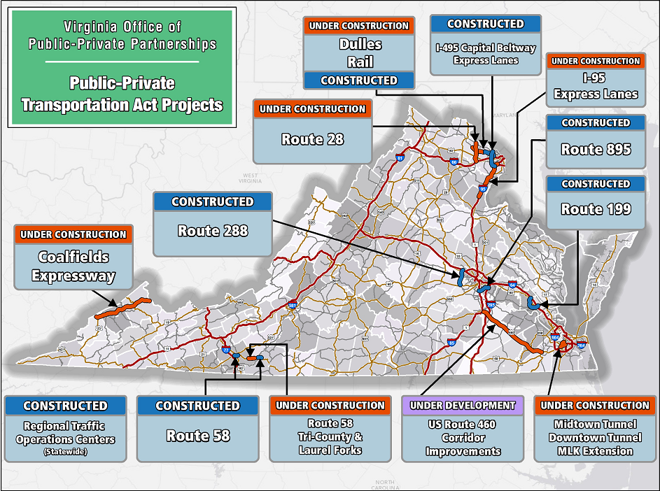
Case Study: VAP3 Projects
Source: www.vappta.org

Slide 22
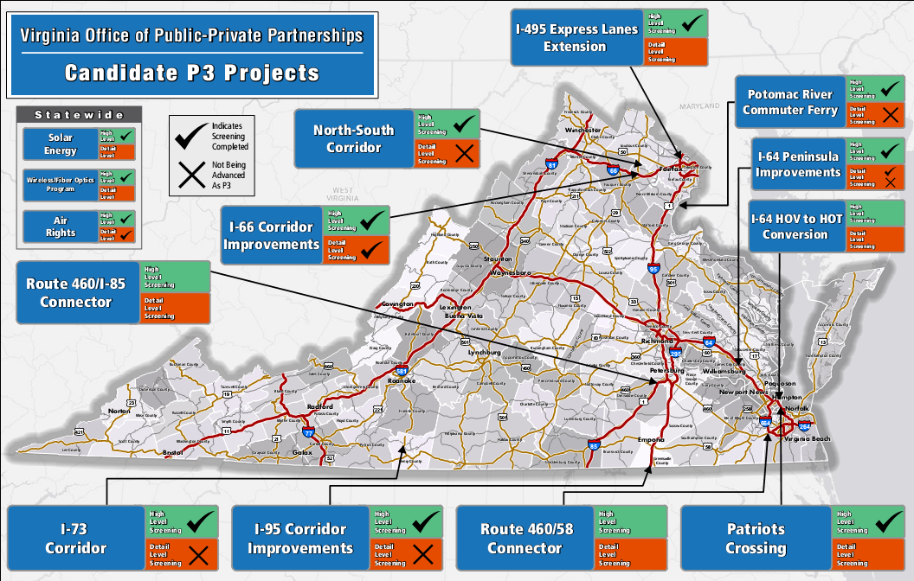
Case Study: VAP3 Pipeline
Source: www.vappta.org

Slide 23
Conclusion
The U.S. P3 Market
Large, fragmented and heterogeneous markets
Municipal bond market
Each state is a distinct market
History of challenges
Political battles, litigation, citizen oppositions
Upward trend, but somewhat uncertain path expected
Market is certain to grow due to the needs of infrastructure investment
Uncertainties regarding political and other risks
Notes:
The U.S. has 14 territories out of which only 5 have permanent, nonmilitary population

Slide 24
Center for Transportation Public-Private Partnership Policy George Mason University
Expanding the evidence base, enhancing agency capacity, educating the workforce and community about P3s
For more information:
Visit us at: p3policy.gmu.edu
Jonathan L. Gifford, Ph.D.
George Mason University
School of Policy, Government, and International Affairs
3351 Fairfax Drive, Arlington, VA 22201 USA
jgifford@gmu.edu / +1(703)993-2275

